Slide 1
Parking Finder Application

Slide 2
Our team
Hesham Elsaady 89431
Belal Abdrabo 89411
Solafa Salem 89409
Esraa Adel 89517
Under the supervision of:
Dr. Maged Khafagy
TA. Ahmed Abdallah
TA. Shereen Youssef

Slide 3
Agenda
1
Introduction
2
Problem Definition
3
Objectives
Related works
System Architecture
6
SW/HW tools
4
5
System Requirements
Methodologies & Algorithms
7
8
System Analysis
9
10
Implementation
11
Time plan
Conclusion
12
13
References

Slide 4
1
Introduction

Slide 5
Introduction
Nowadays the world is getting bigger and It is thought the number of drivers is getting bigger on a daily at most people already own at least one car so the number of drivers is getting bigger on a daily and more people are having an issue that they cannot find a place to park their car easily and it takes them a lot of time therefore our target is to try to improve the previous issue. Our app allows user to compare spots, pre-book for parking, repaid and give his feedback as his opinion matters to us.

Slide 6
2
Problem definition

Slide 7
Problem definition
Our problem can be defined as the unorganized way of parking in Egypt. Drivers can waste much time trying to find a vacant spot in the street or nearby garage to park their cars. Such as searching for a vacant spot in a street especially if it's crowded it may take a long time, or searching for empty spot can take a long time too. Which may lead to the possibility of parking the car in an unauthorized or unsafe parking spot and result in even more crowded and unorganized streets.

Slide 8

3
Objectives

Slide 9
Objectives
As it raised our attention to the problem of the unorganized process of parking in the streets and the difficulty to find all garages in specific areas. It became our objective to solve this problem by using the advanced technology of our generation so they can be directed to the nearest parking easily with the needing to pre-pay for them.

Slide 10
4
Related works

Slide 11
Related works
App/Feature | SpotHero | Best parking | Parknav | Parkmobile | Our app
Pre-booking | X | X |  |  | X
Feedback | X |  |  |  | X
Bookmark | X |  |  | X
Free trial |  |  | X
Not free | X | X | X | X | X
Cancel reservation | X
Scan code |  |  |  |  | X

Slide 12
5
System Archeticture

Slide 13
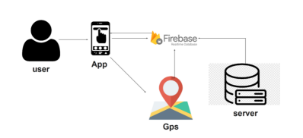
System Architecture
System architecture means the conceptual model that defines the structure, behaviour and more views of a system. And our system architecture here defines how the user interact with the application through GPS. We use map service provider to build the map in our application, we use Google Maps API key to track the location and firebase to support our platform and store user’s information.

Slide 14
6
SW/HW tools

Slide 15
SW/HW tools
Software Tools:
Operating system:
Windows, Unix, Linux, IOS and Android.
Coding language:
Flutter, Dart.
Editor:
Android Studio, VS code.
Hardware Tools:
Computer, laptop:
With Ram minimum of 2 GB. With 20+ hard disk, SSD preferred With CPU Core i3 running 2.5GHz or higher
Mobile Phone:
Working with Android or IOS

Slide 16
7
System requirements

Slide 17
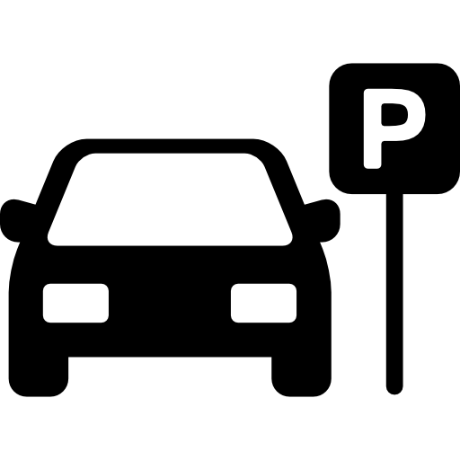
Functional Requirements FR
Registration and login.
Request a location to park at.
Choose whether to go to streets
System returns list of locations available to the user’s desired destination with estimated duration and price.
Choose to get directions to one of the locations returned.
Route directions from the user's location to the chosen spot are illustrated.
Users can view reviews about the chosen location and can also add review.
Users can add specific locations to their list of bookmarks.
When a user starts a trip, the place is added to their history.
Users can edit their info (username, email, phone number, password).

Slide 18
Non-Functional Requirements NFR
Availability
Reliability
Scalability
Performance
Security
Usability
Extensibility

Slide 19

8
System analysis

Slide 20
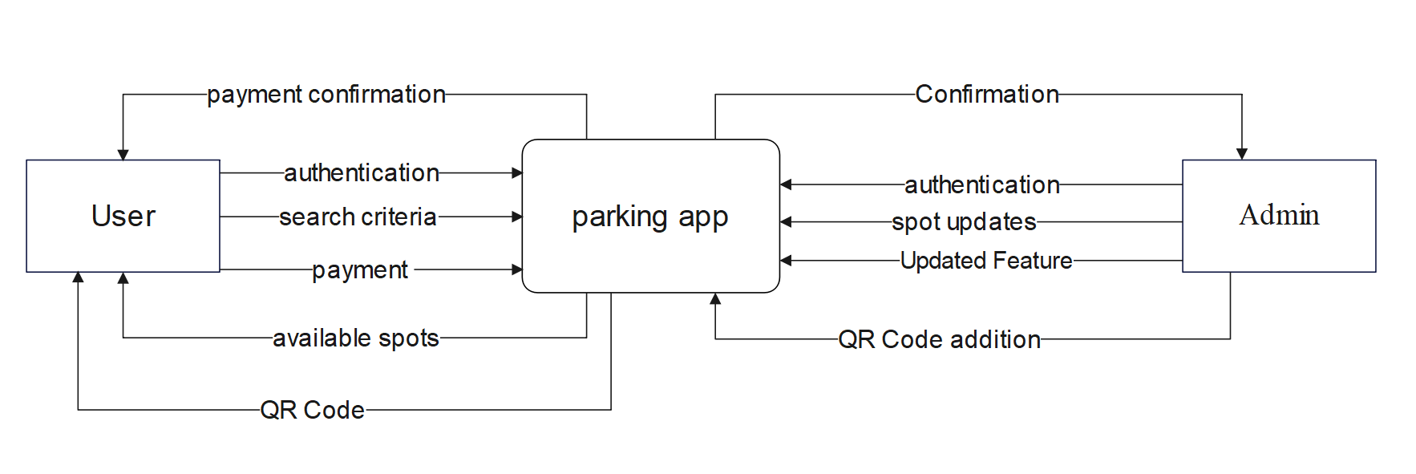
Context Diagram

Slide 21
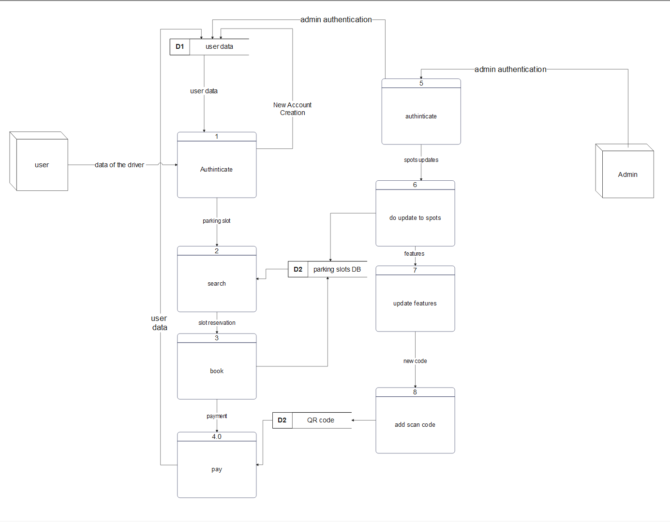
DFD (Level 0)

Slide 22
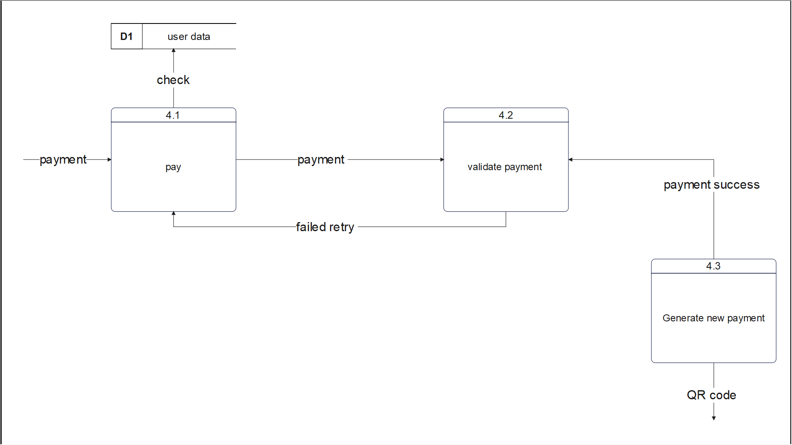
Child Diagram

Slide 23
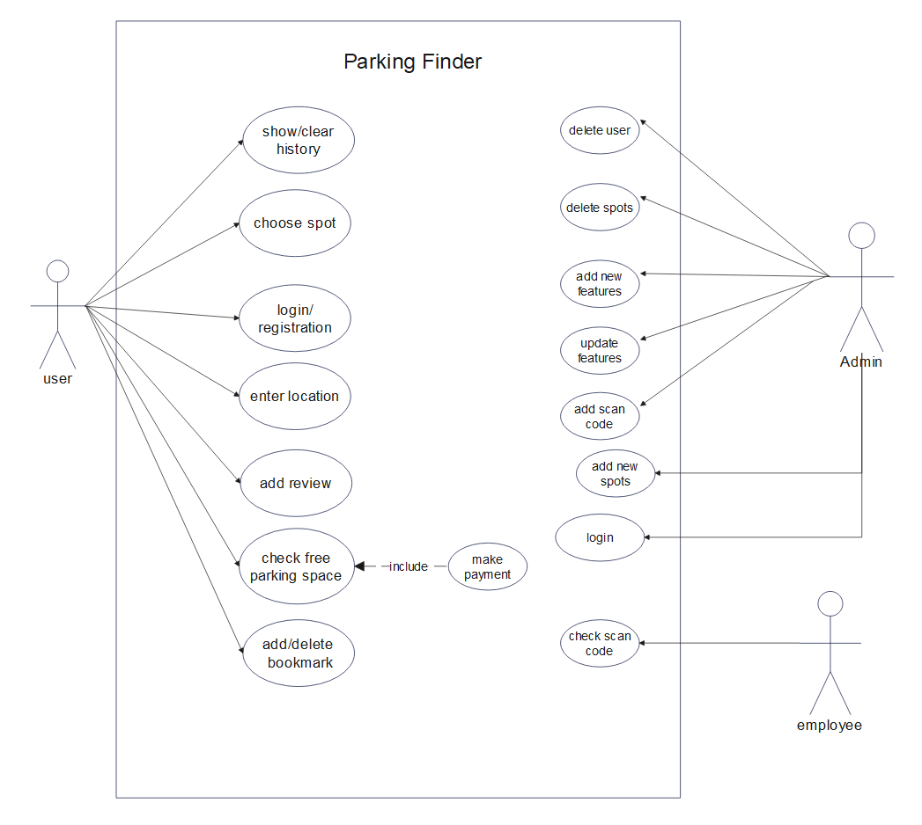
Use-case Diagram

Slide 24
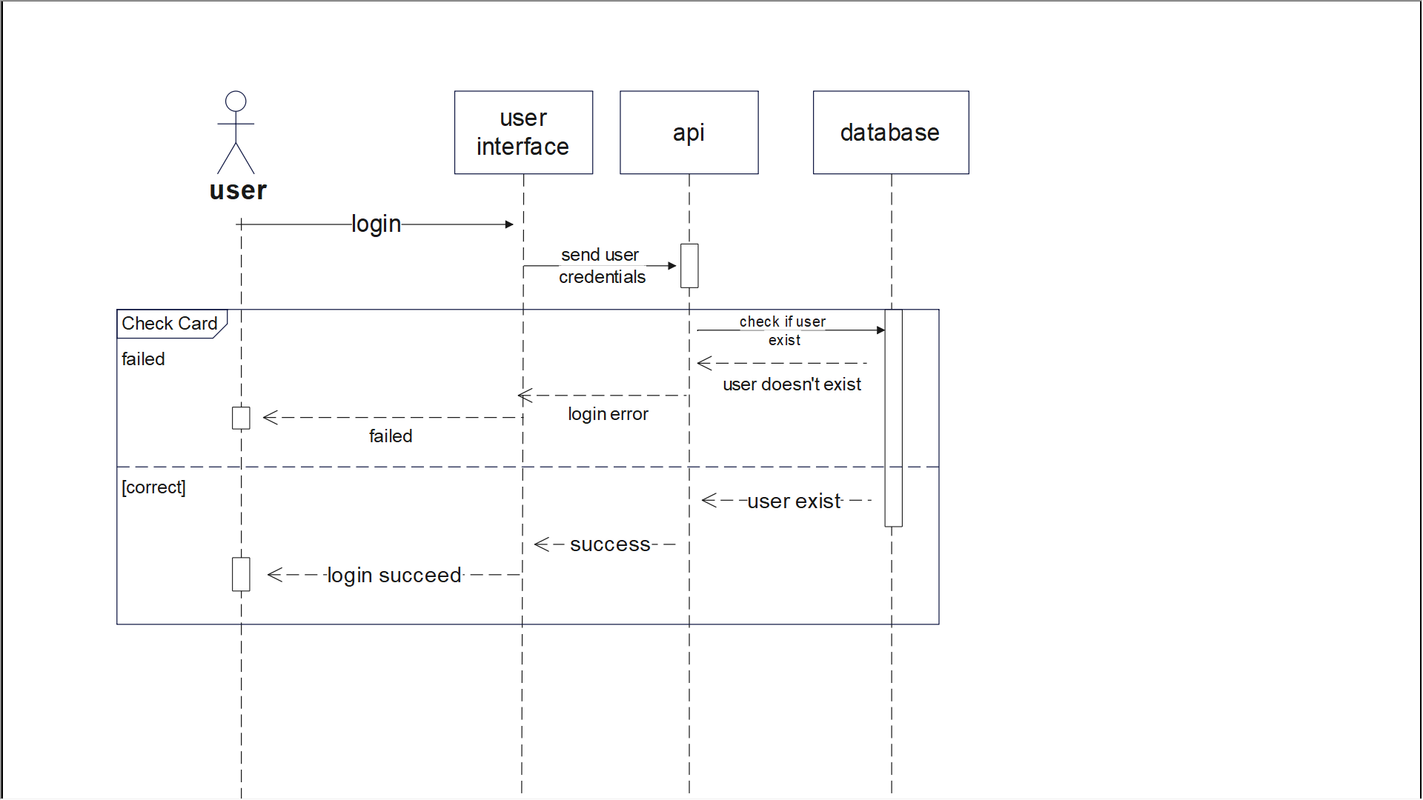
Sequence Diagram for Login (1/5)

Slide 25
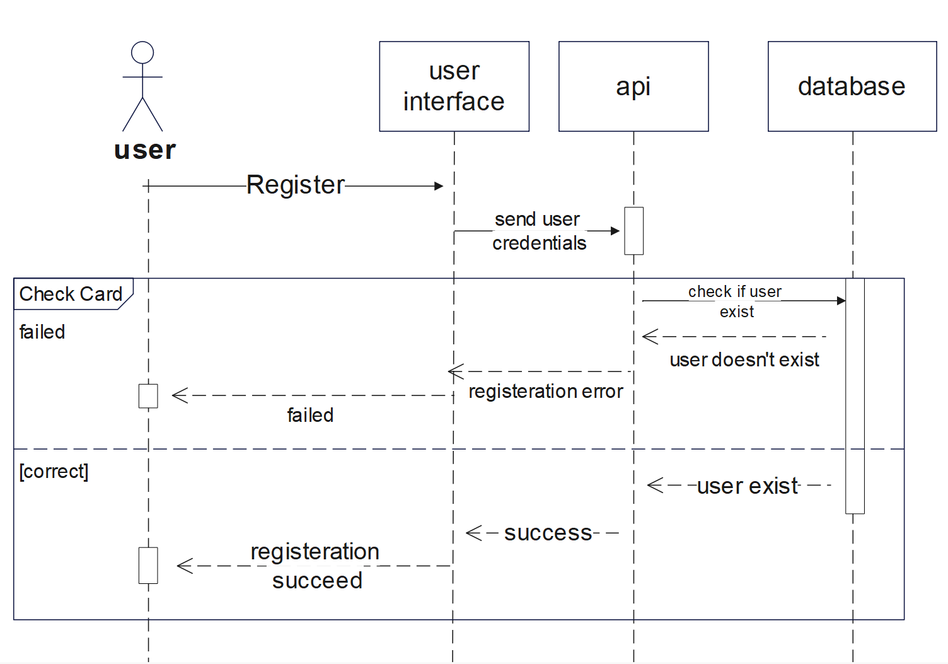
Sequence Diagram for Registration (2/5)

Slide 26
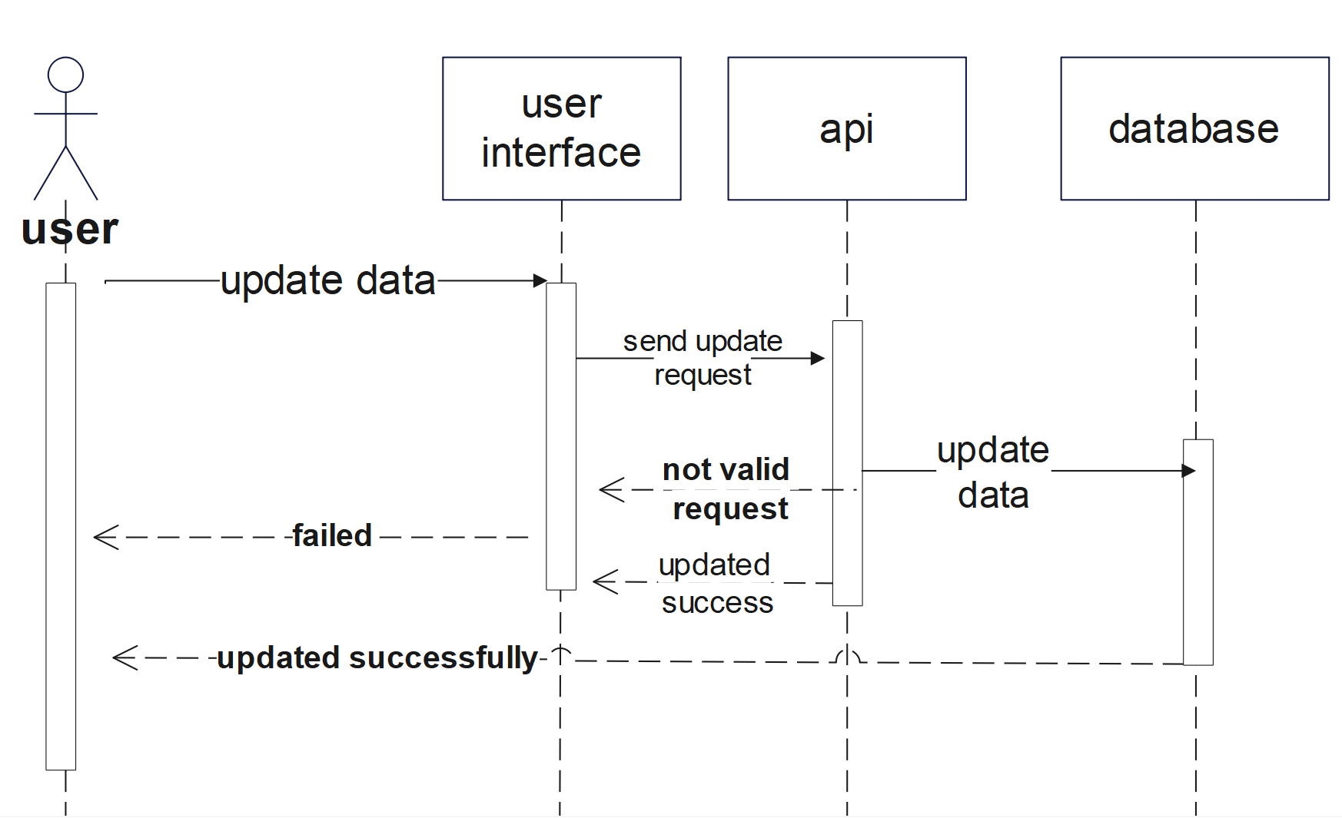
Sequence Diagram for Updating(3/5)

Slide 27
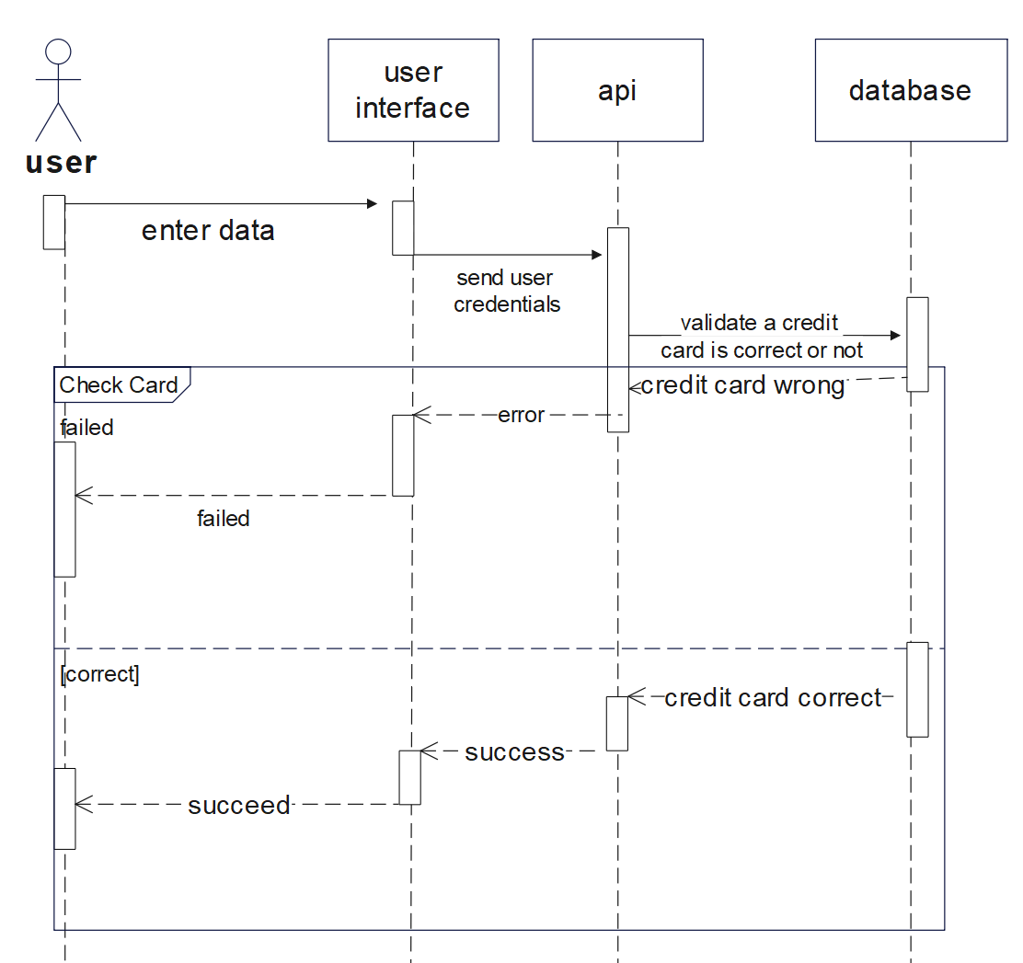
Sequence Diagram for Payment(4/5)

Slide 28
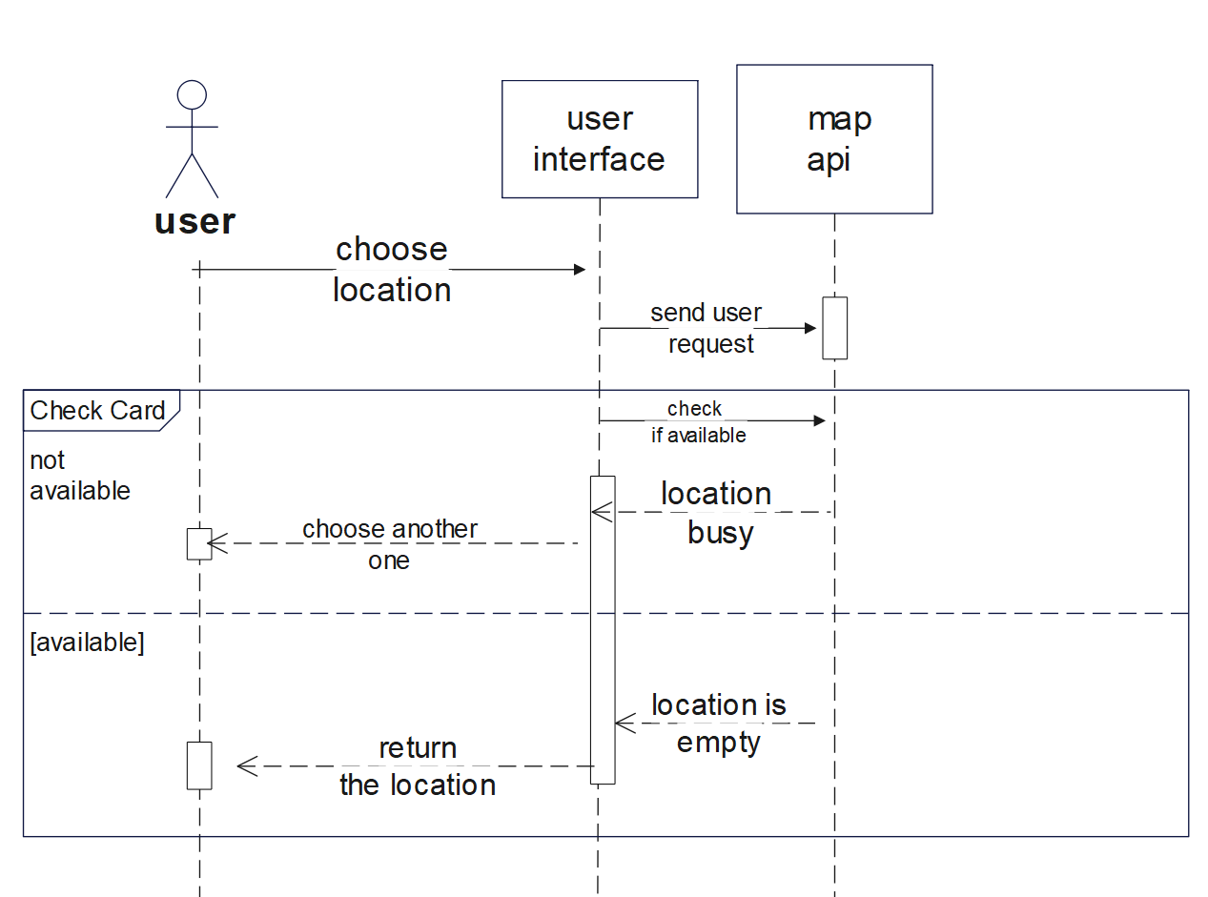
Sequence Diagram for Location(5/5)

Slide 29
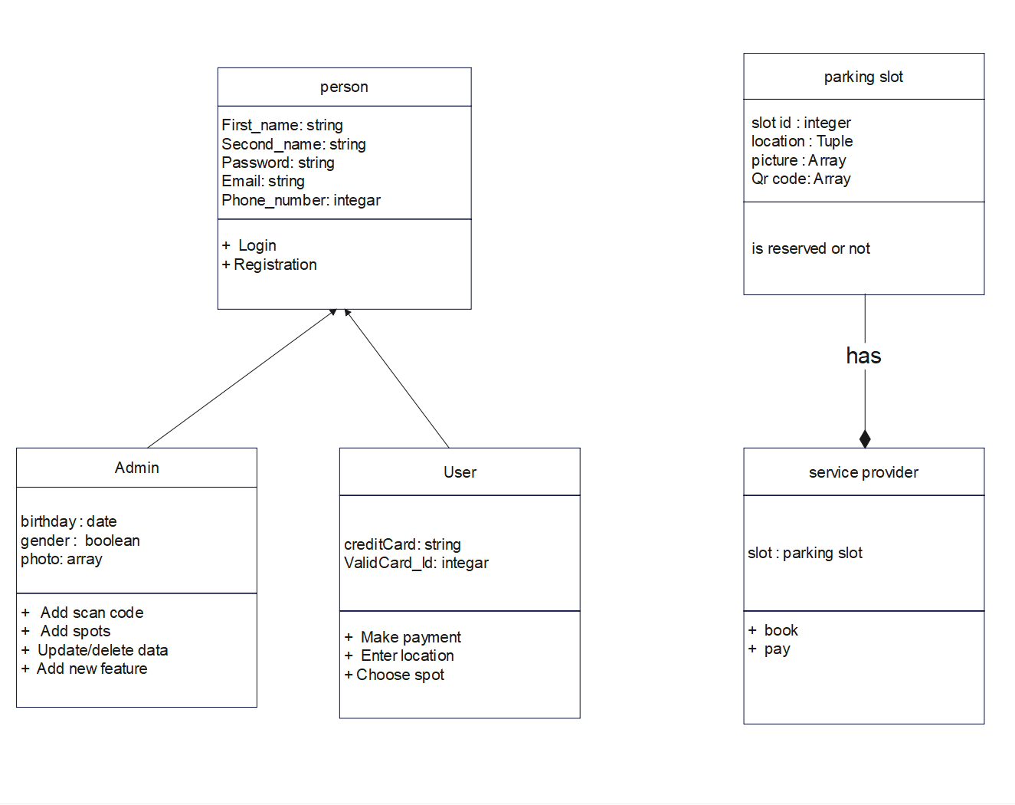
Class Diagram

Slide 30
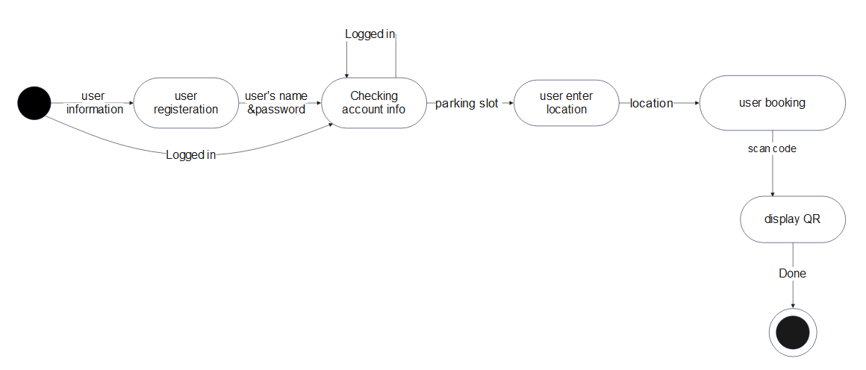
State-chart Diagram

Slide 31
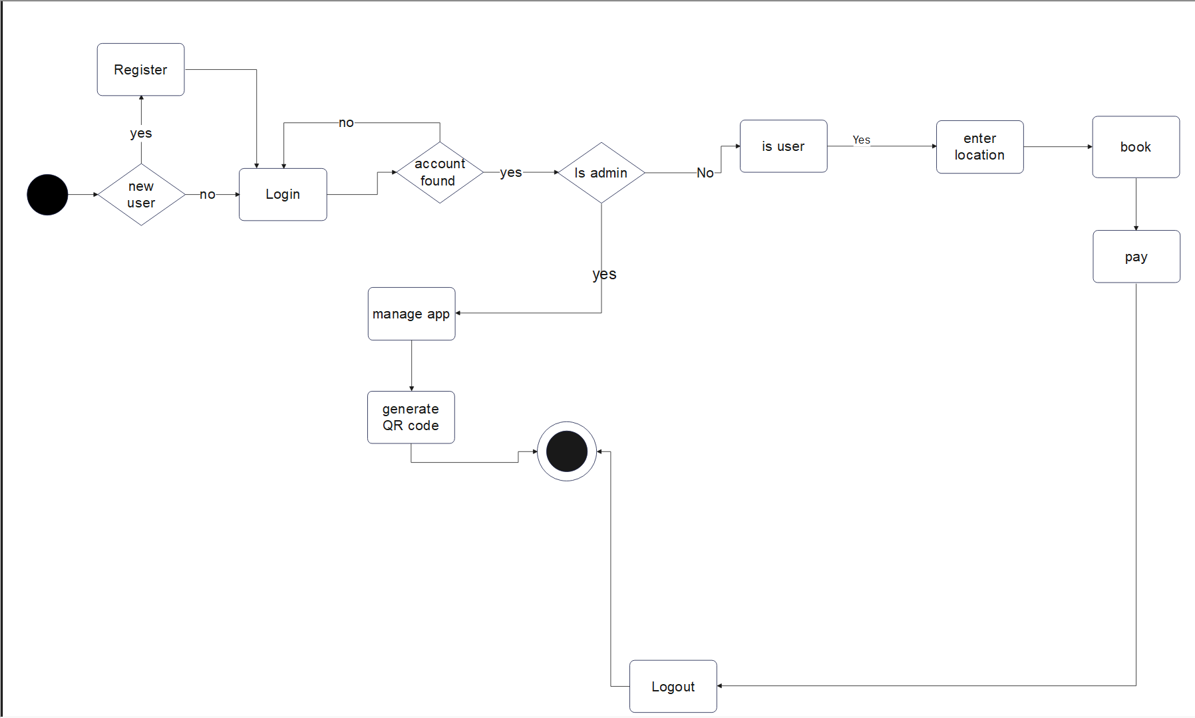
Activity Diagram

Slide 32
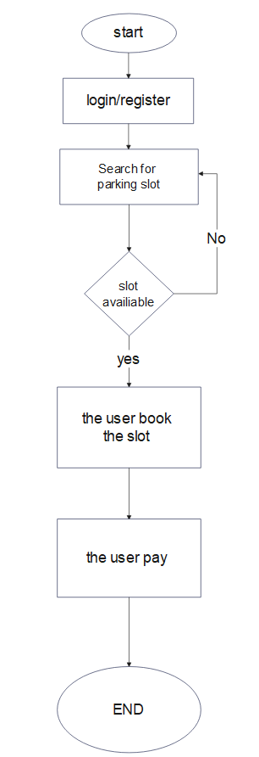
Process Flow Diagram (PFD)

Slide 33
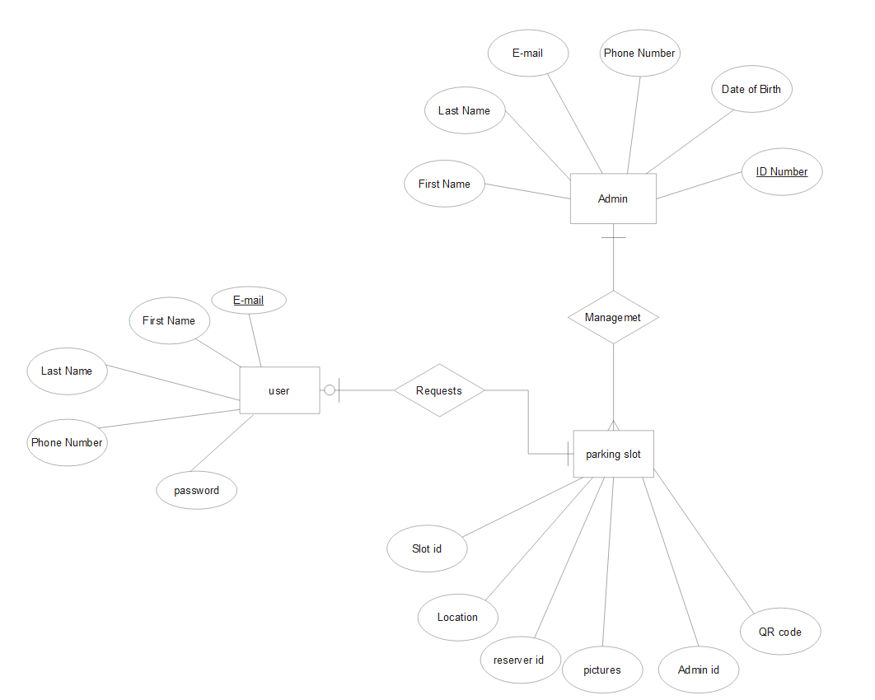
Entity Relationship Diagram (ERD)

Slide 34
9
Methodologies & Algorithms

Slide 35
Algorithms
Firebase Authentication
Firebase Fire store
One-time passwords (OTP)
Methodologies
Agile Methodology
To verify E-mail and password.
It is a project management methodology purposely adopted for the development of sophisticated software.
Cloud real time database.
Authentication
It is the process of identifying users that request access to a system, network, or device. Access control often determines user identity according to credentials like username and password.
It’s an algorithm that provide a mechanism for logging on to a network or service using a unique password that can only be used once, as the name suggests
Encryption
It is a method that used to transform data into ciphertext

Slide 36
10
Implementation

Slide 37
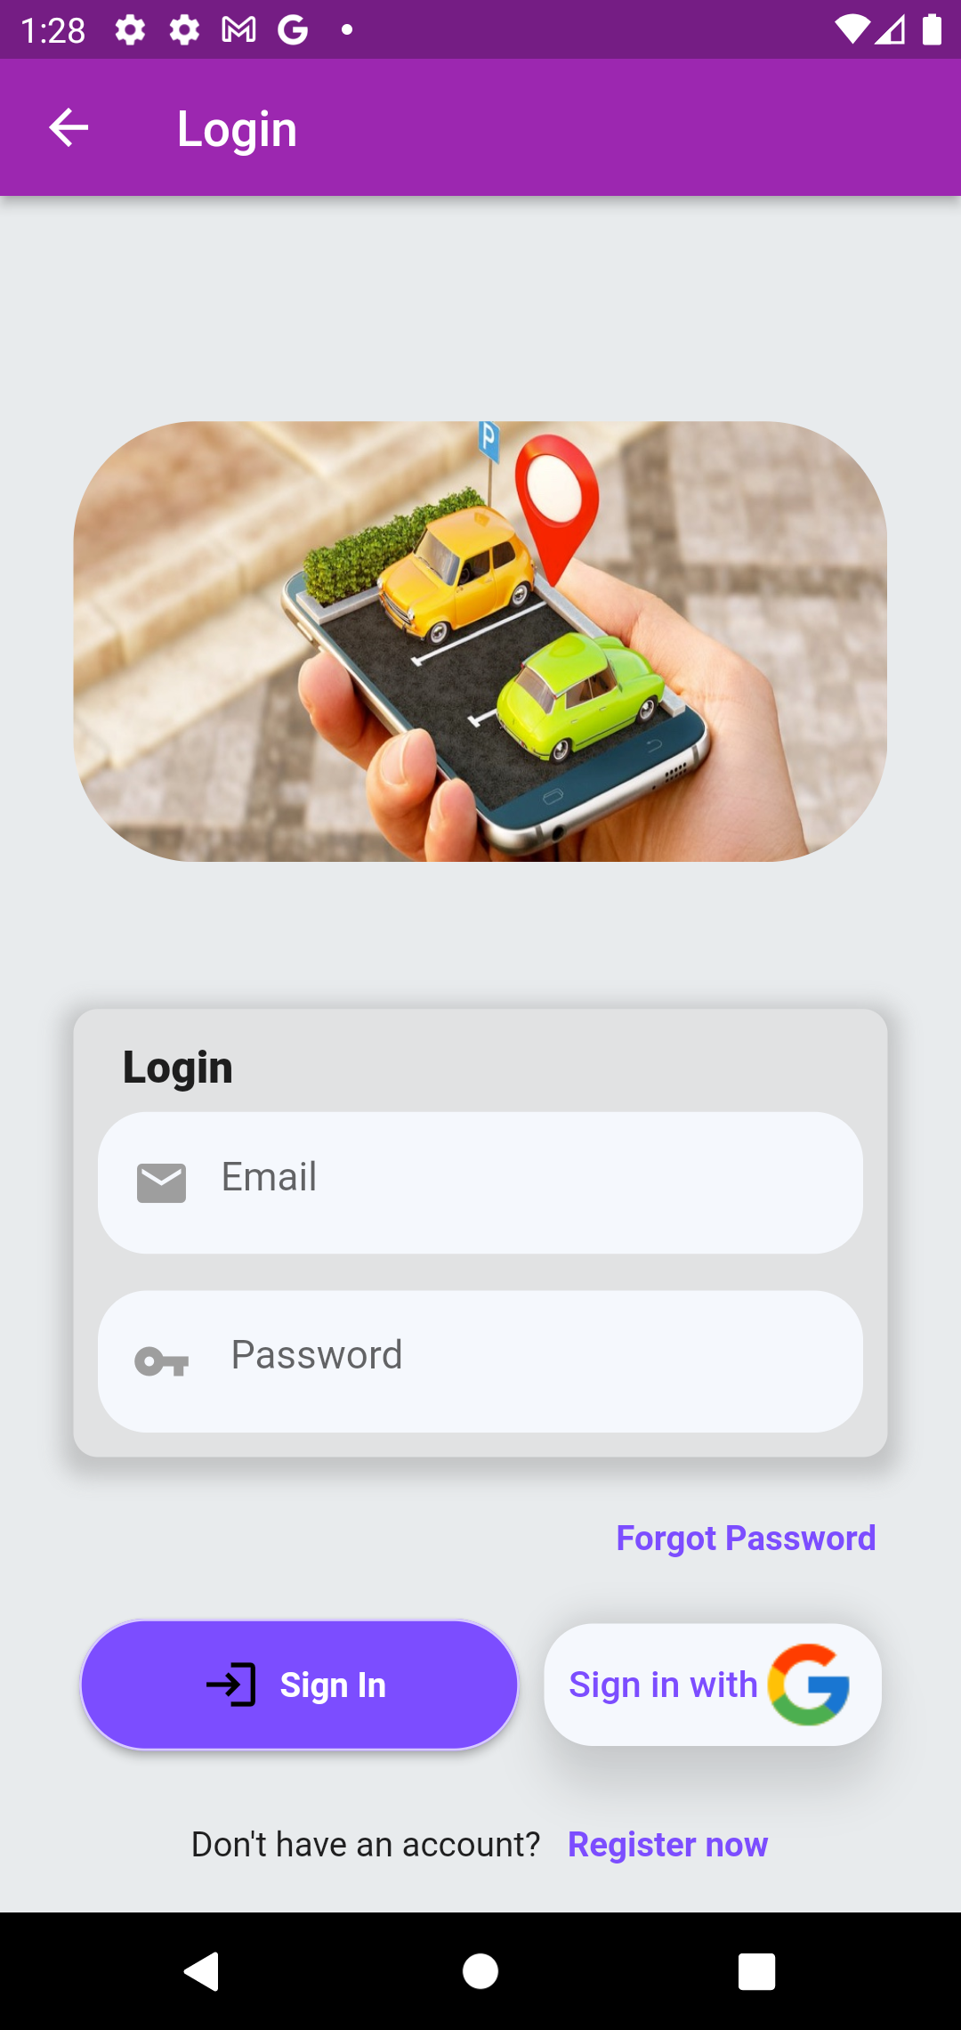
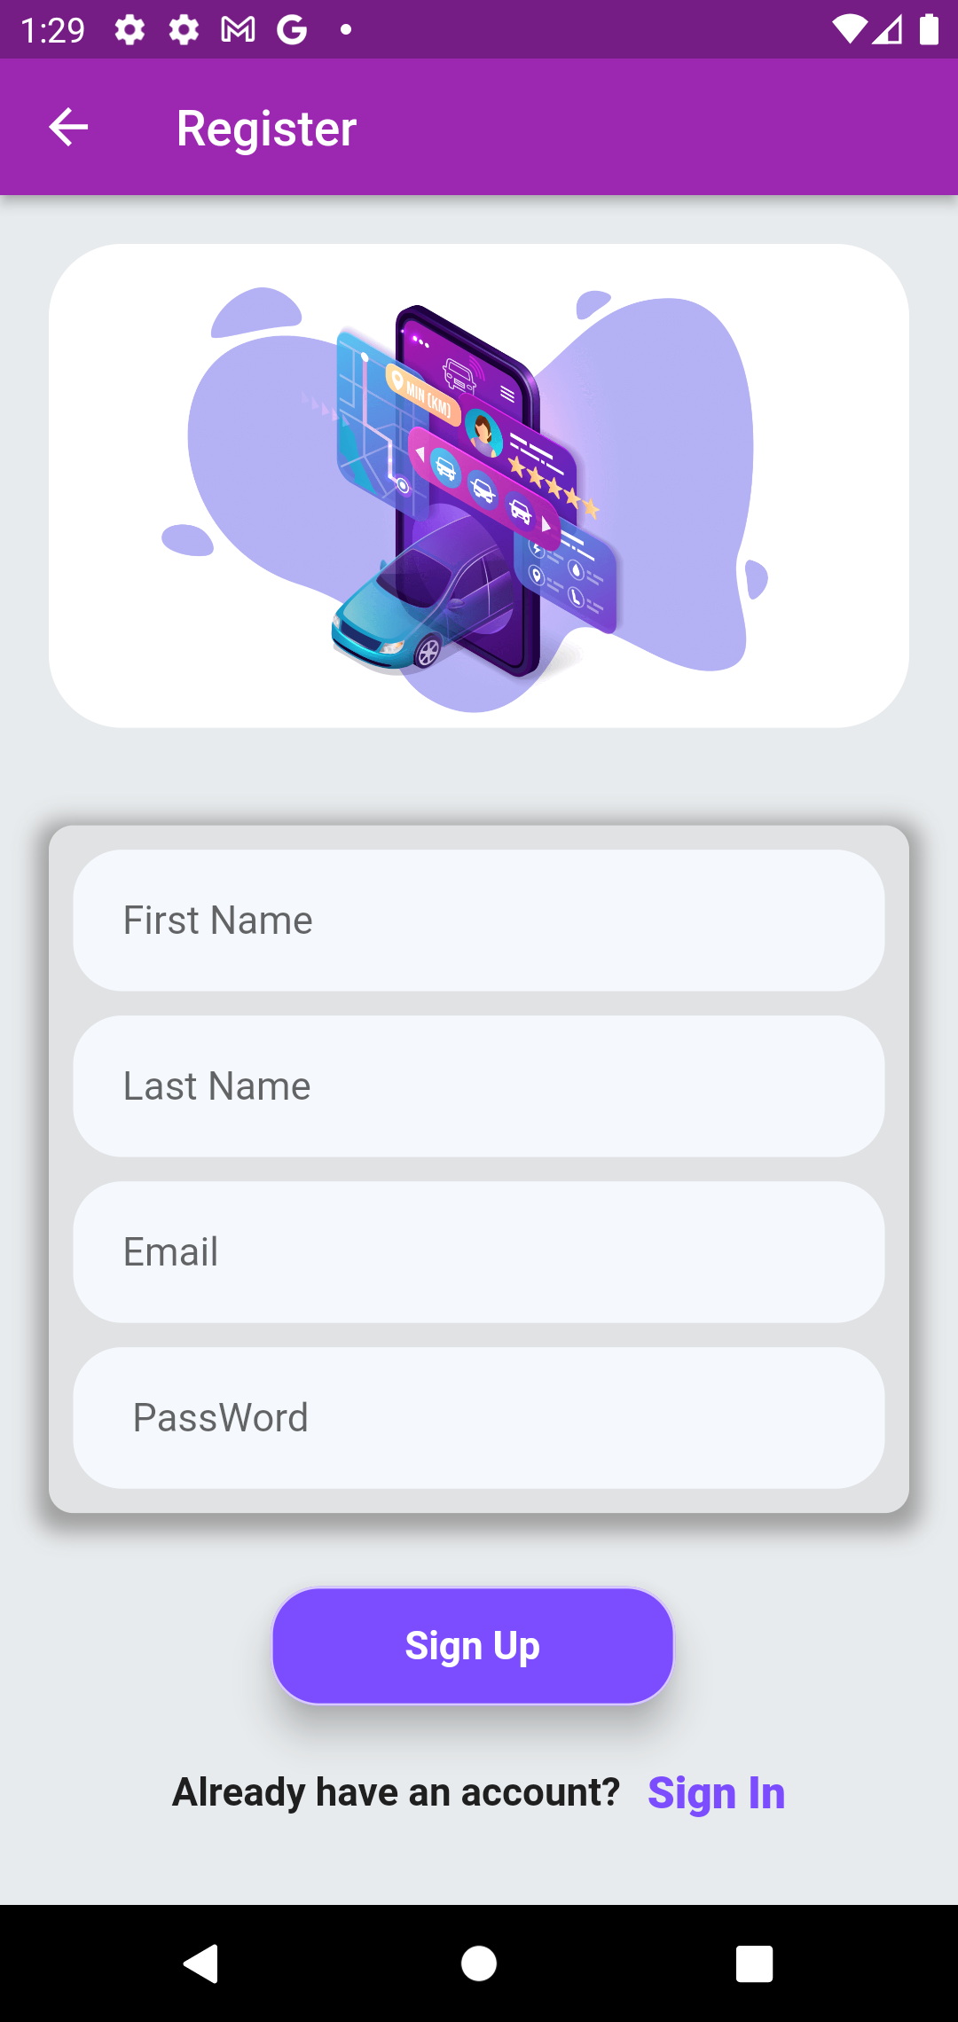
Login
Signup

Slide 38
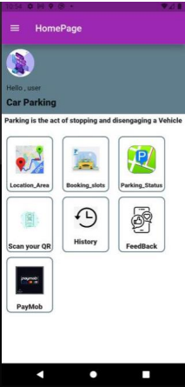
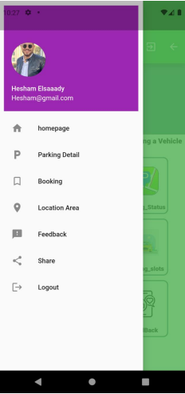
Home
Drawer

Slide 39
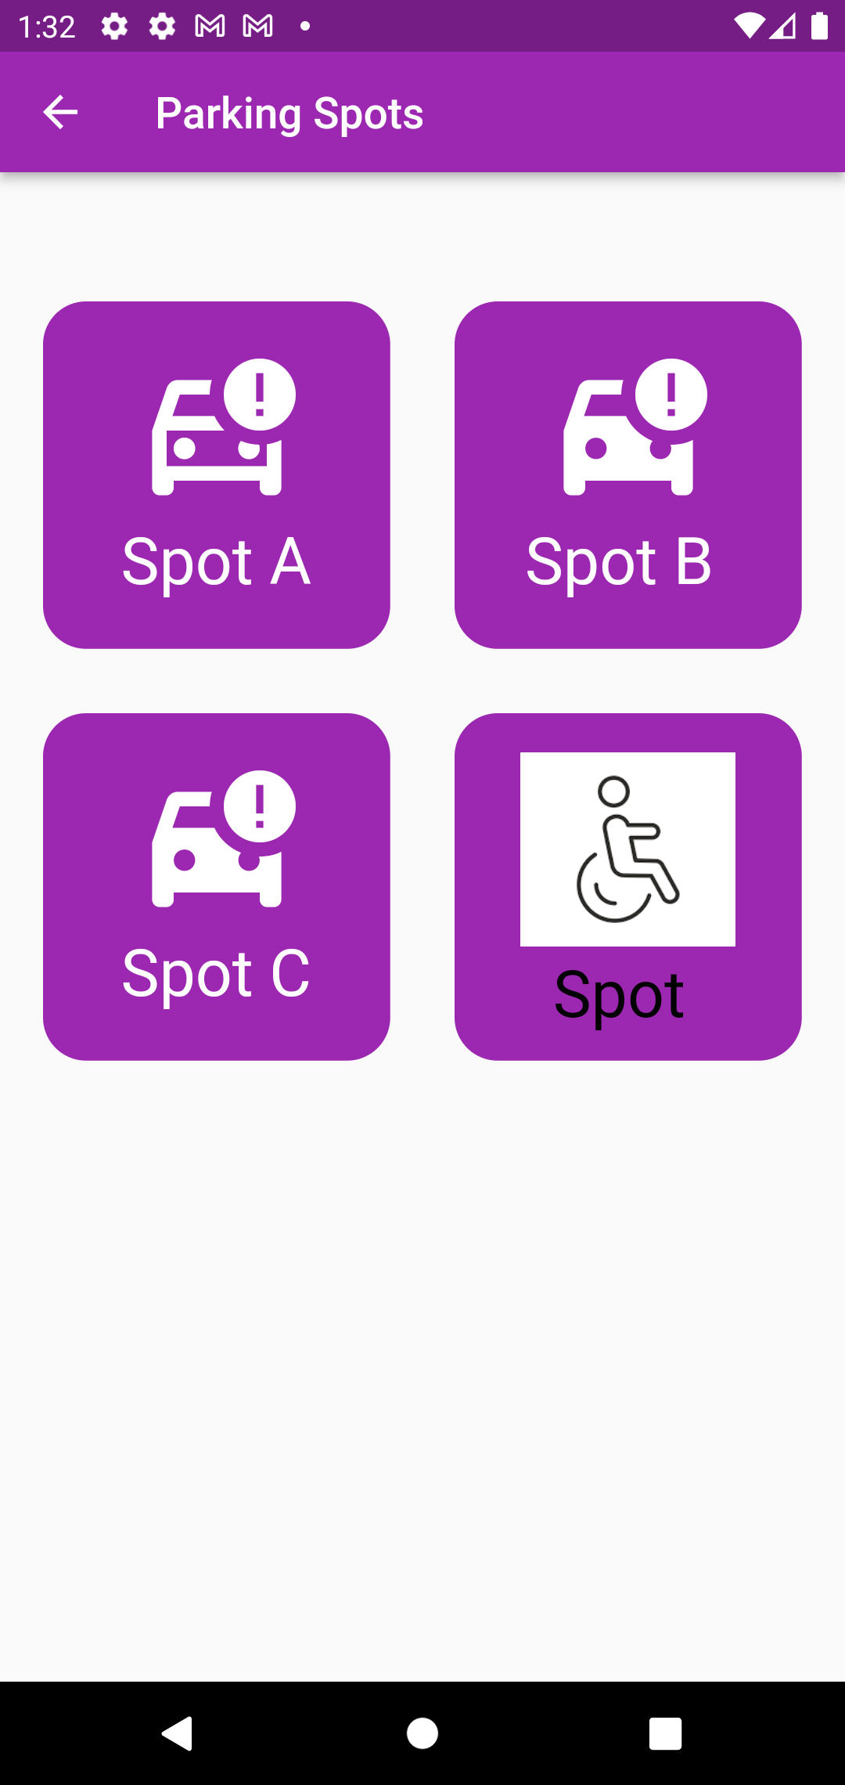
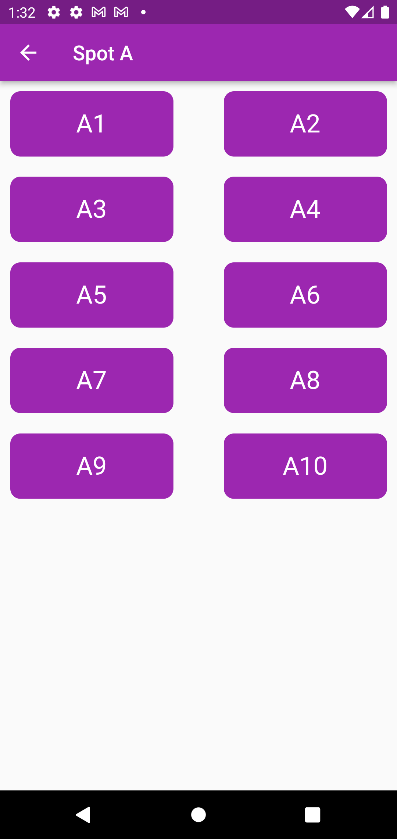
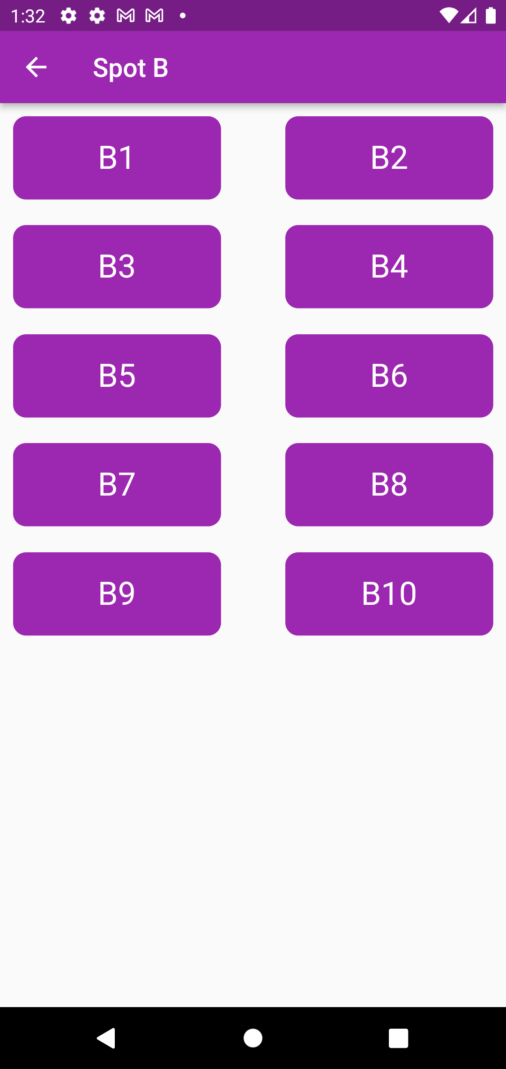

Parking spots

Slide 40
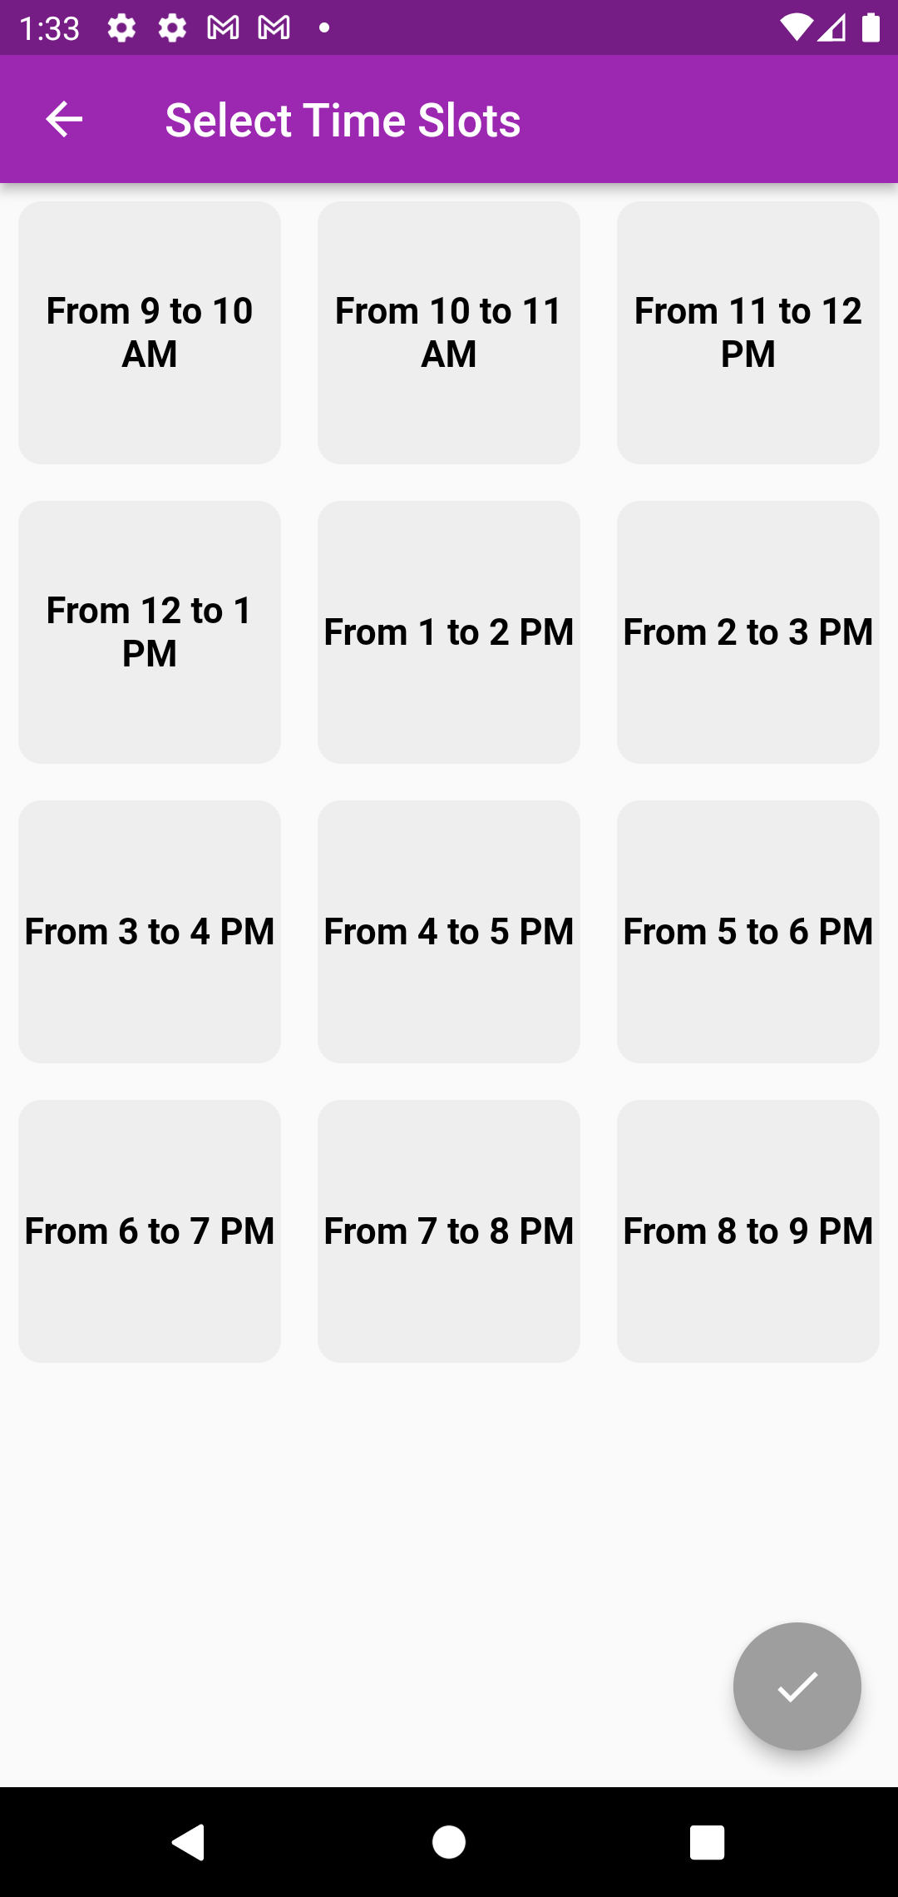
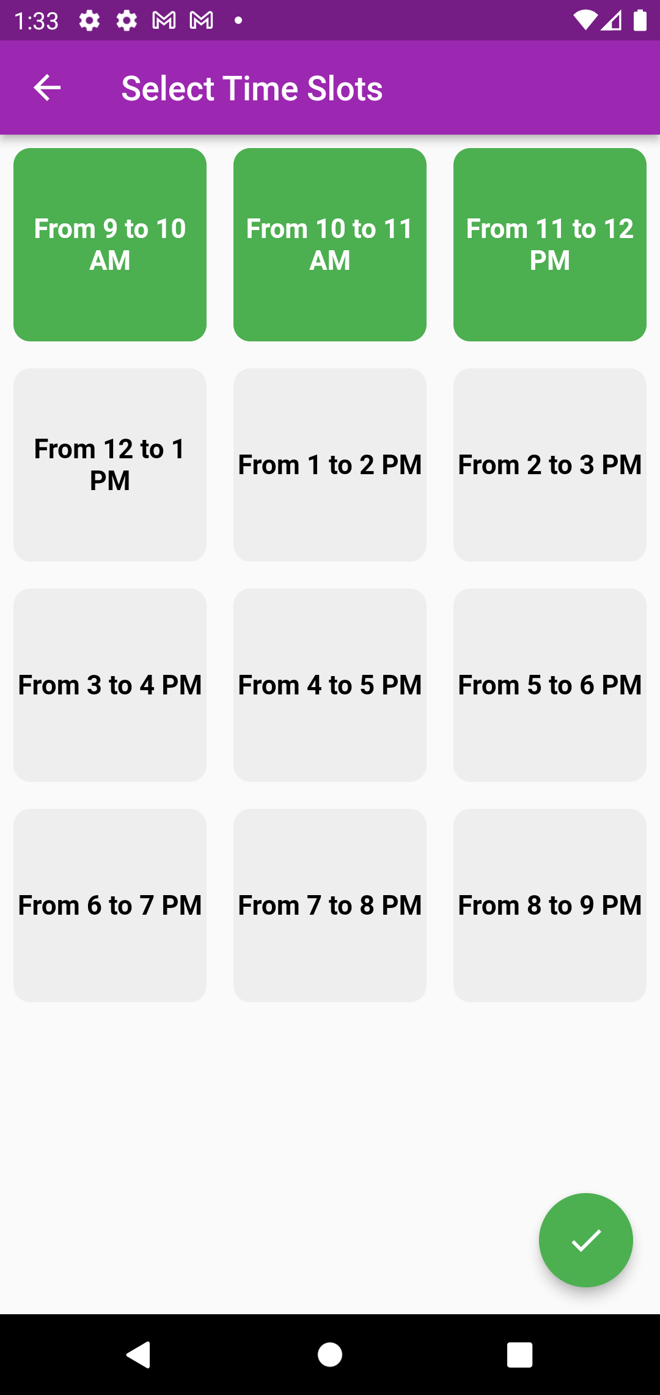
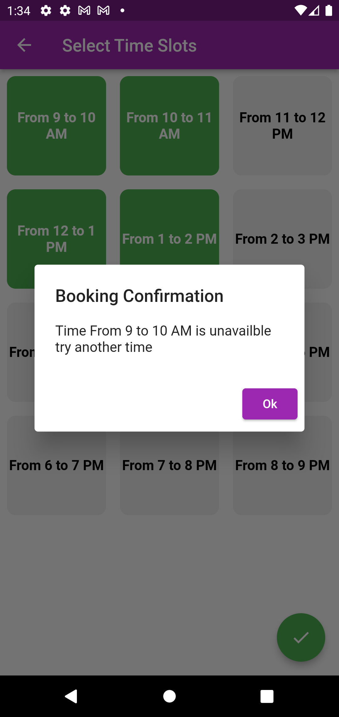
Choose time
Unavailable time

Slide 41
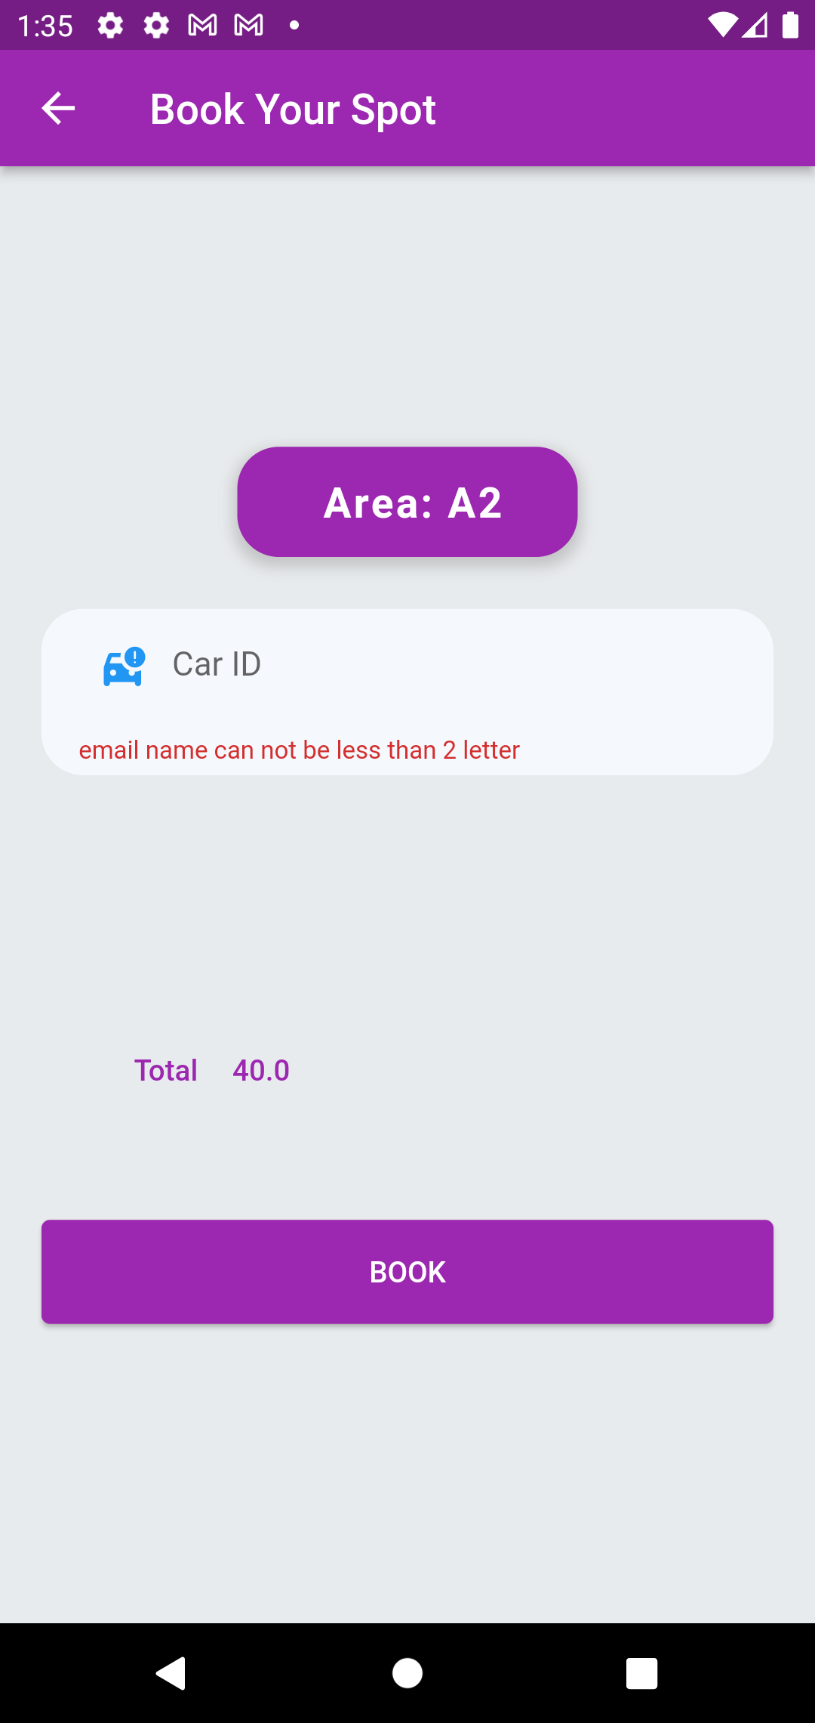
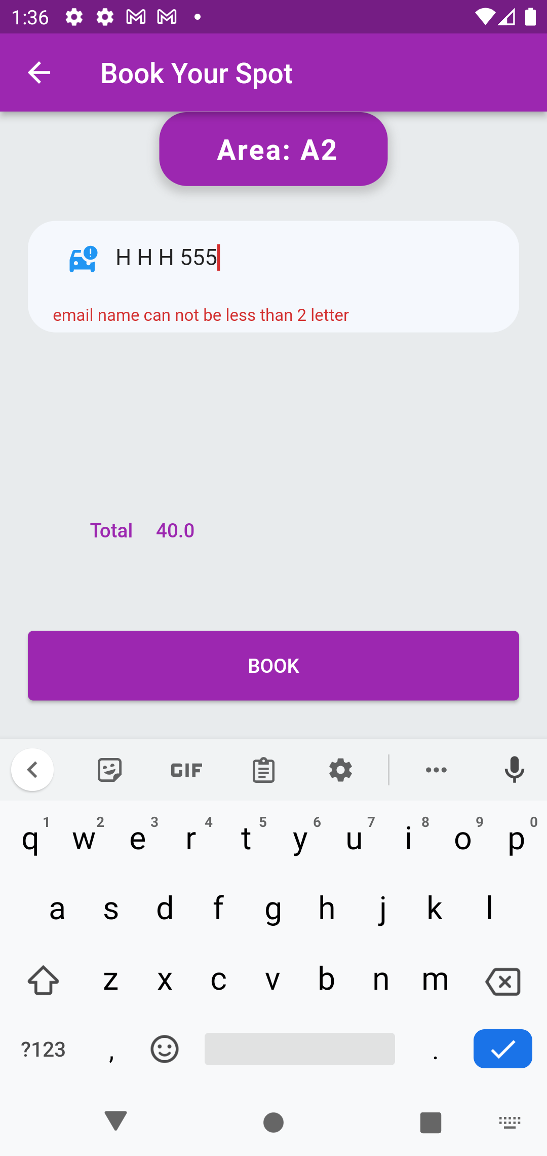
Booking

Slide 42
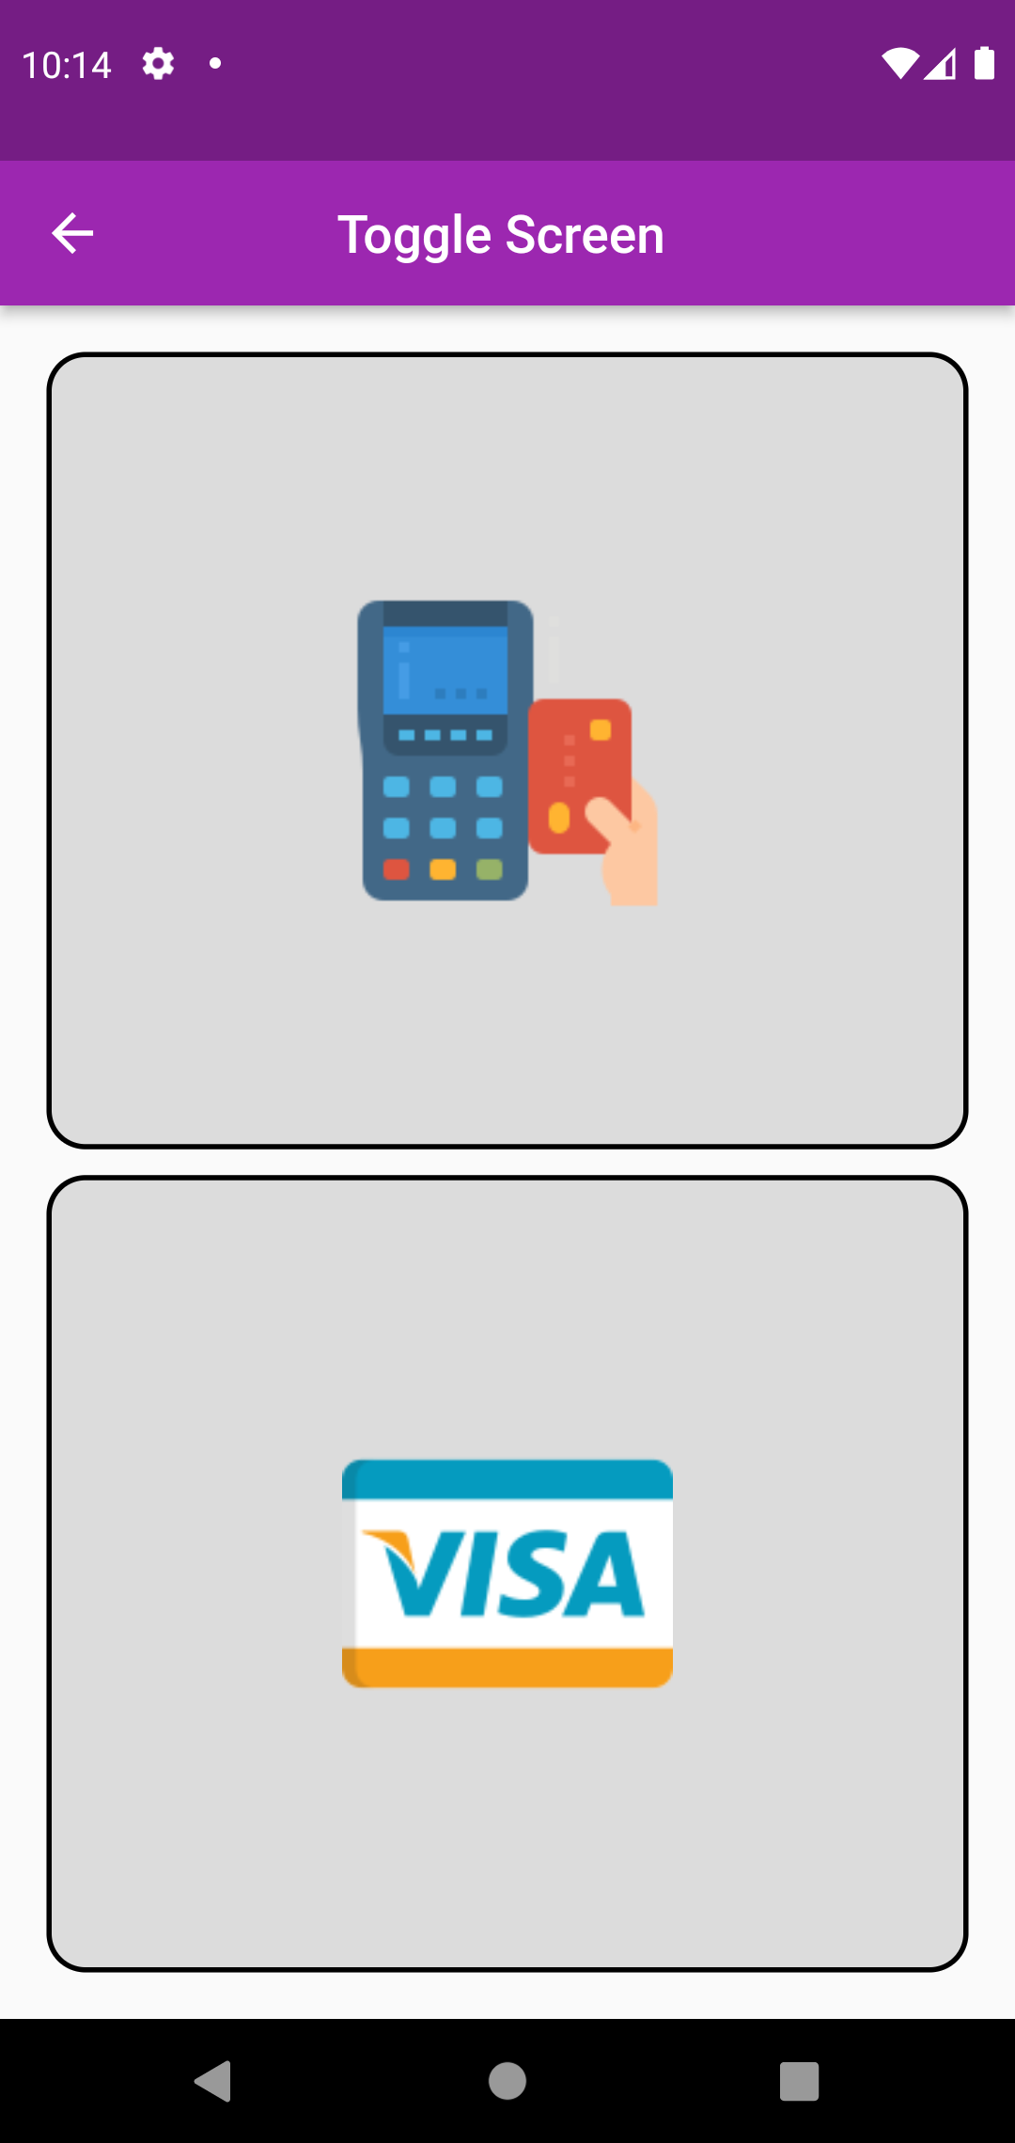
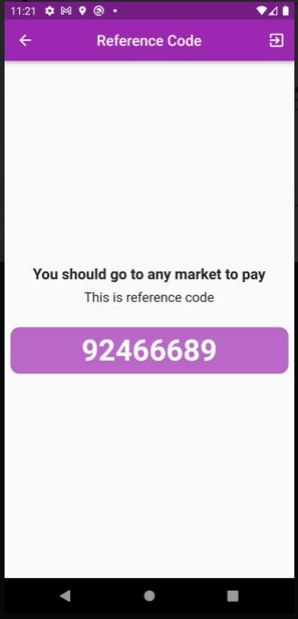
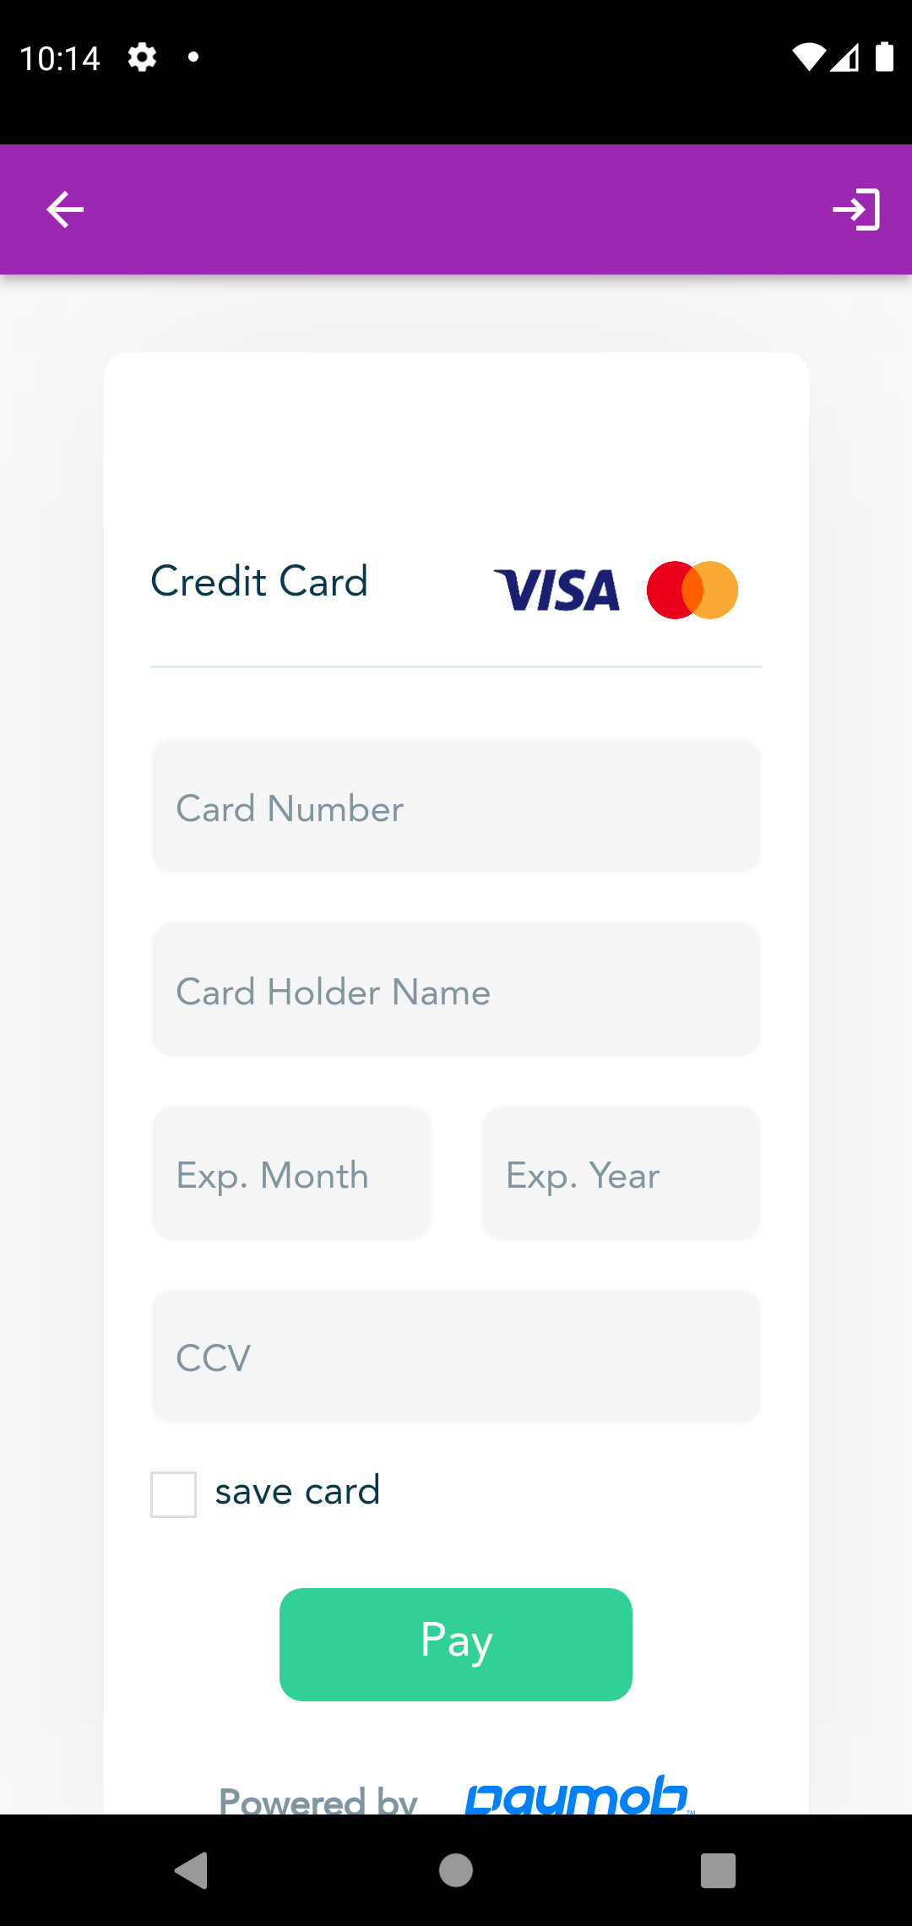
Payment
Fawry
Visa

Slide 43
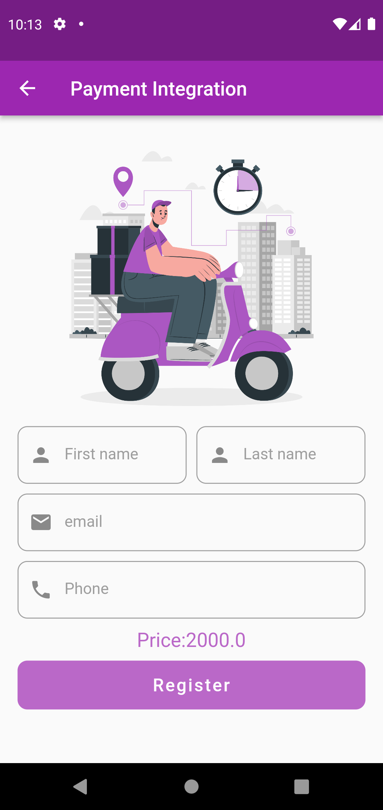
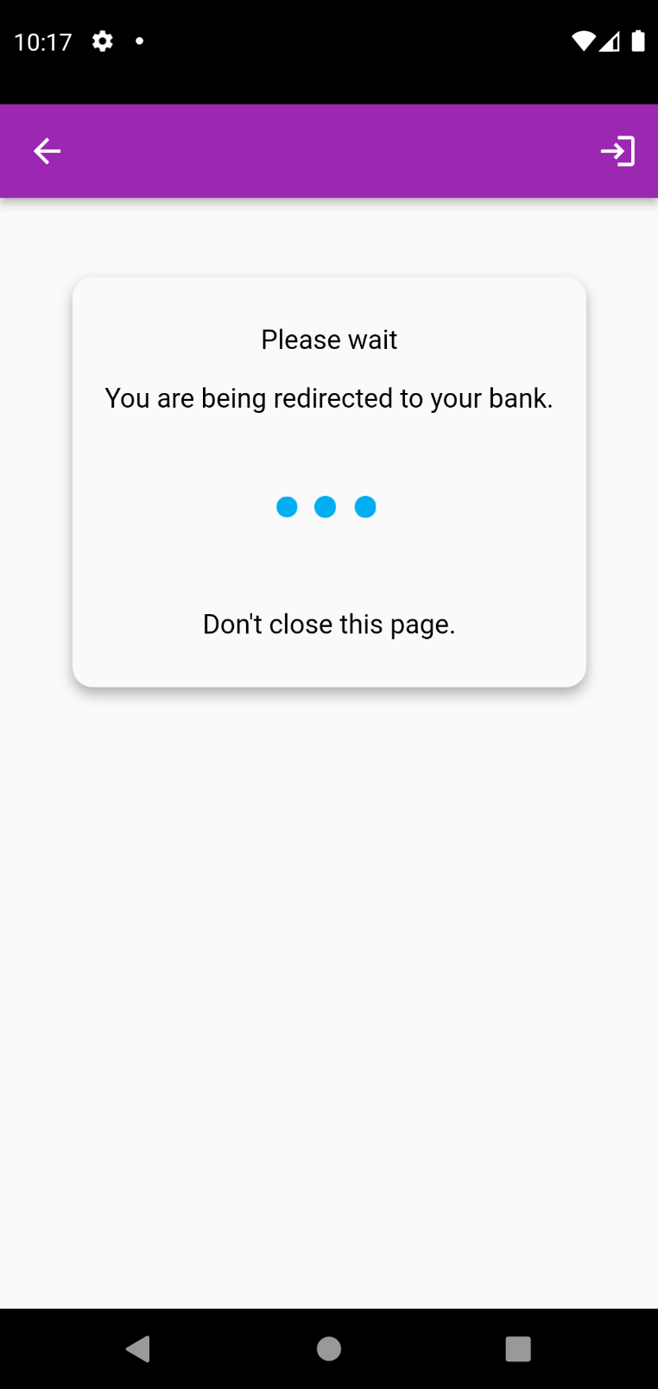
Payment integration (VISA)
Verification

Slide 44
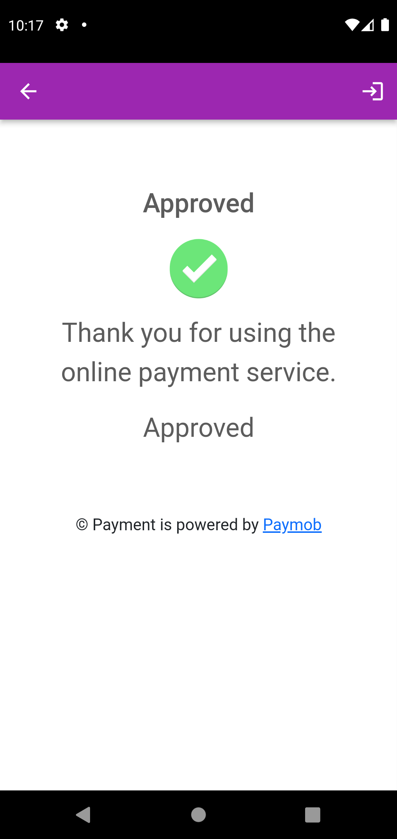
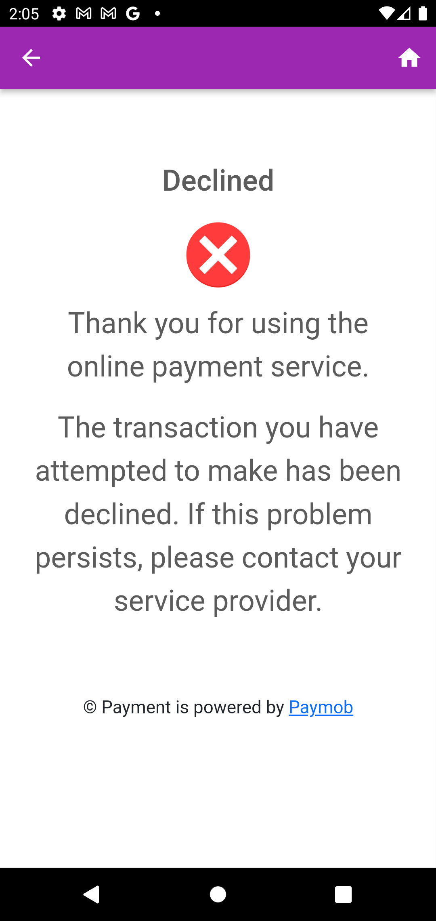
Approved
Declined

Slide 45
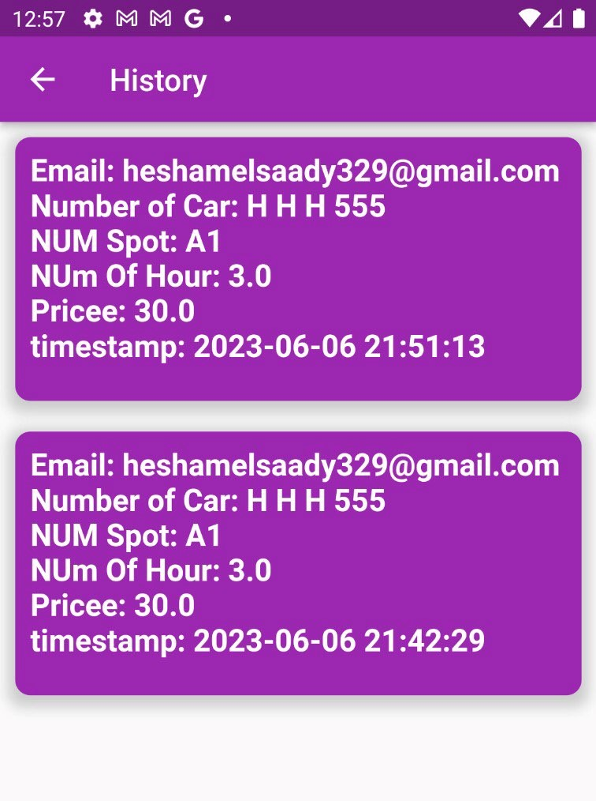
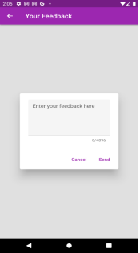
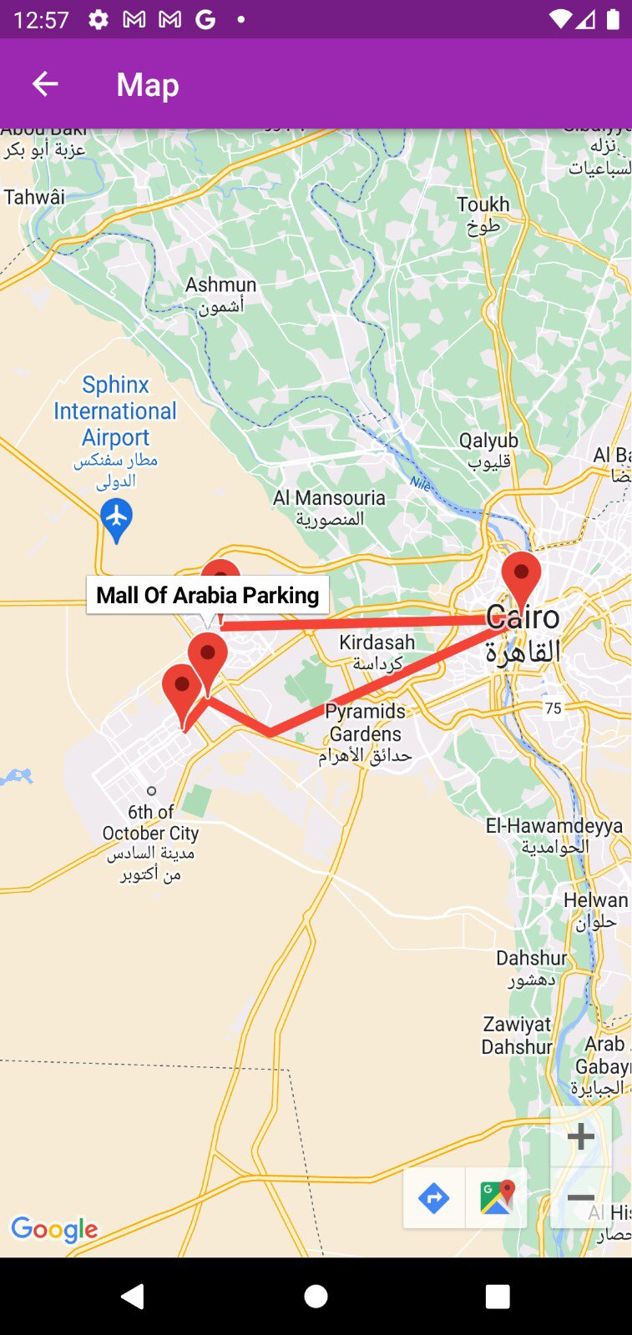
History
Feedback
Map

Slide 46
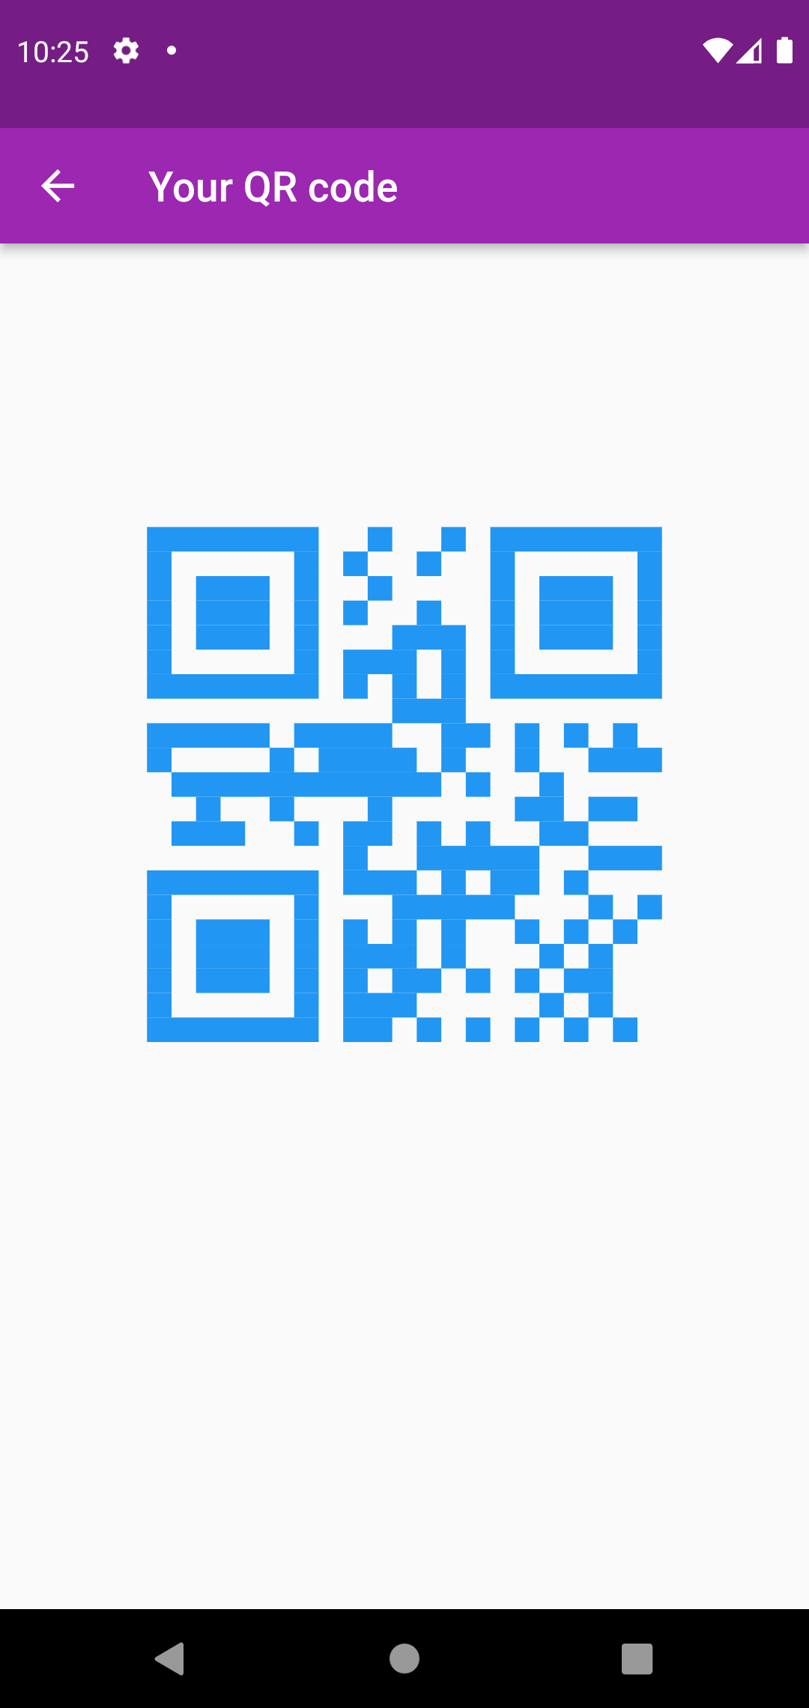
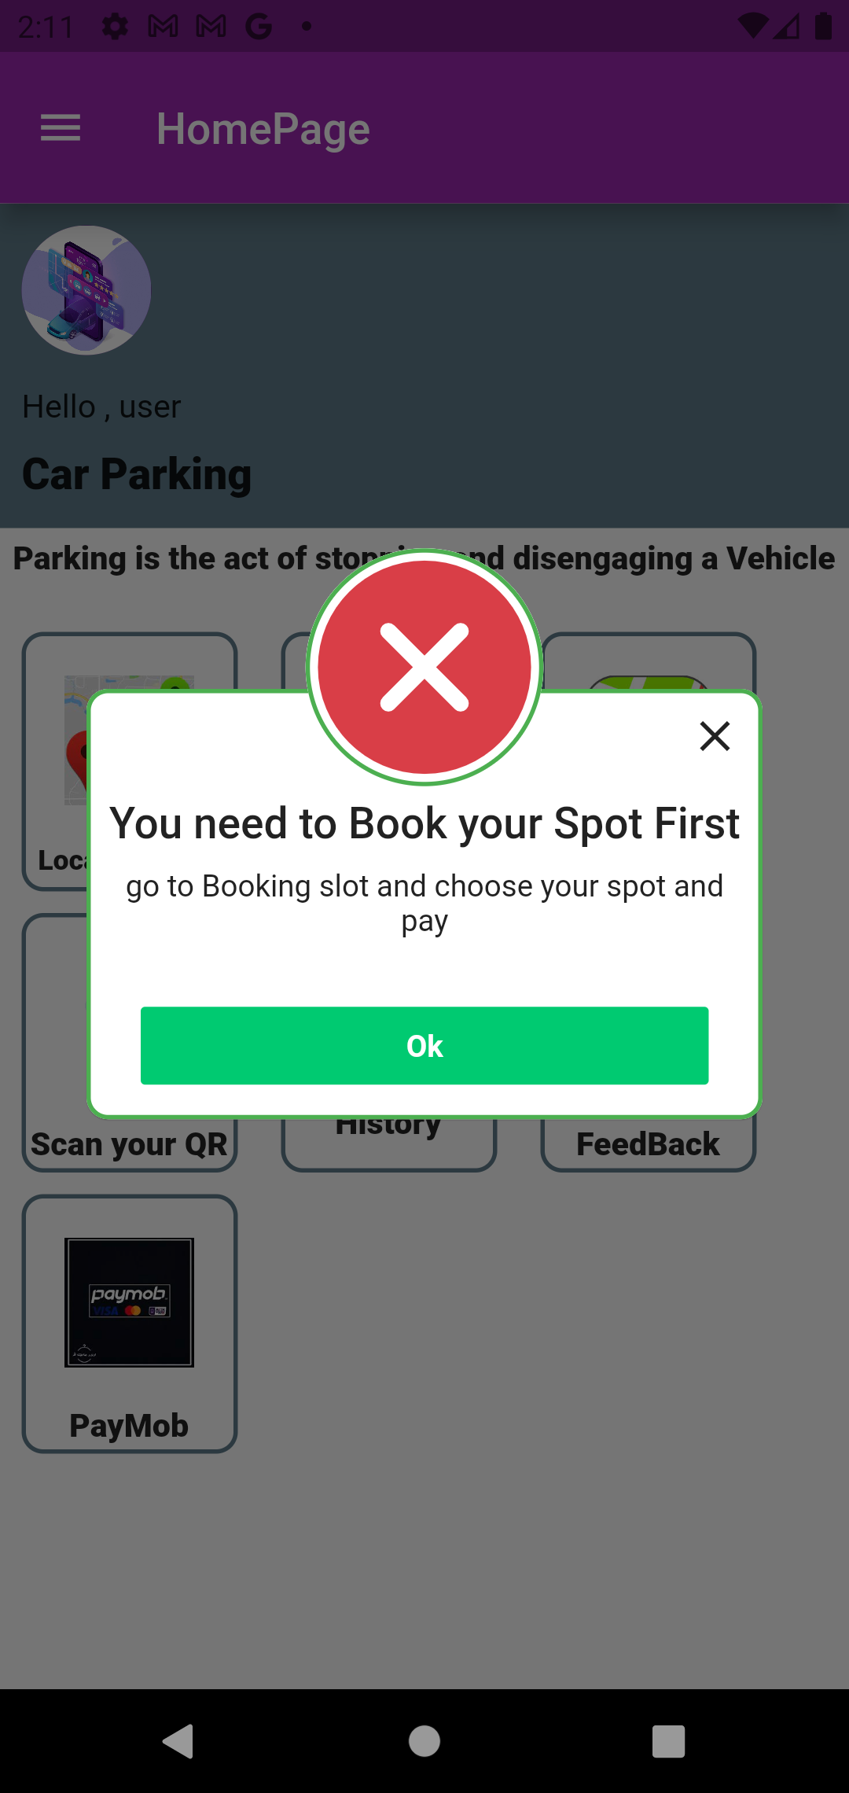
QR code

Slide 47

Demo videos
Login/Signup

Slide 48
Booking

Slide 49
Payment

Slide 50
QR code/Map

Slide 51
11
Time plan

Slide 52
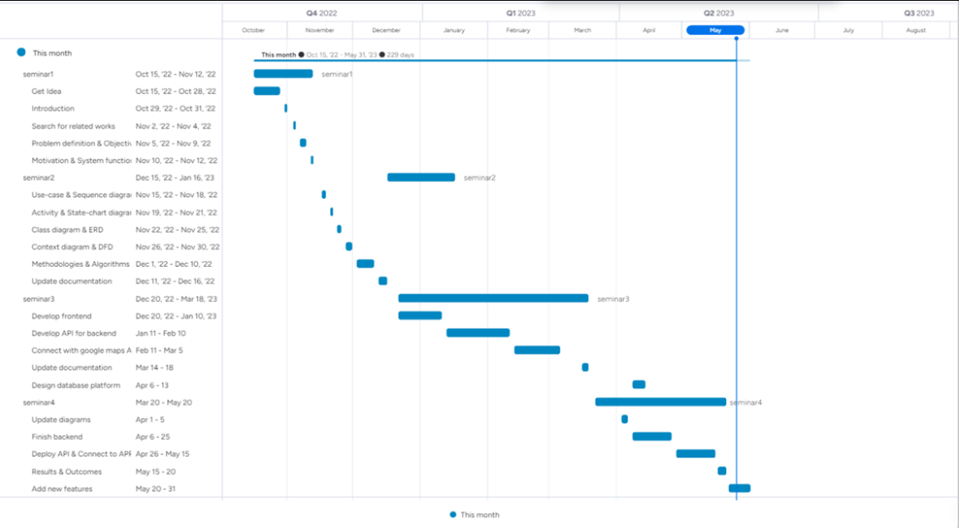

Slide 53
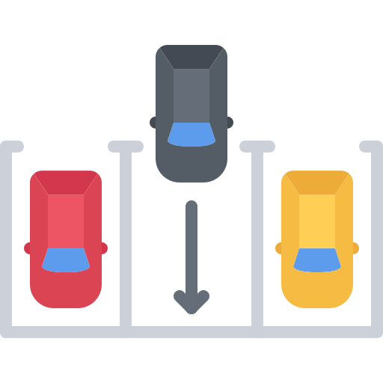
12
Conclusion

Slide 54
Conclusion
Our goal was to make an application that provides users an easy way of reserving a parking online where users can view various parking spaces and select nearby or specific area of their choice to view whether space is available or not. If the booking space is available, then user can book it for specific time slot. The booked space will be marked and will not be available for anyone else for the specified time. Users can also view previous parking booking details, it will saves user time and effort. At the end, we have come up with a program that made it easier for drivers to find suitable vacancies for them in terms of time and money.

Slide 55
13
References

Slide 56
References
L. Wenghong, X. Fanghua, and L.Fasheng, “Design of inner intelligent car parking system,” in International Conference on Information Man. 11. Gao, X., Gu, Z., Kayaalp, M., Pendarakis, D., & Wang, H. 2017. ContainerLeaks: Emerging security threats of information leakages in container clouds. In 2017 47th Annual IEEE/IFIP International Conference on Dependable Systems and Networks (DSN) (pp. 237- 248). IEEE
R.H Ellis et al. Structuring a systems analysis of parking. Highway Research Record (1970).
Barata, E., L. Cruz, and J.P. Ferreira. Parking at the UC Campus: Problems and Solutions. Cities, Vol. 28, No. 5, 2011, pp. 406–413.
Van der Goot, D. A Model to Describe the Choice of Parking Places. Transportation Research Part A: General, Vol. 16, No. 2, 1982, pp. 109–115.
Khattak, A., and J.W. Polak. Effect of Parking Information on Travelers’ Knowledge and Behaviour. Transportation, Vol. 20, No. 4, 1993, pp. 373–393.
Young, W. A Review of Parking-Lot Design Models. Transport Reviews, Vol. 8, No. 2, 1988, pp. 161–181.
Saltzman, R.M. Three Proposals for Improving Short-Term On-Street Parking. Socio-Economic Planning Sciences, Vol. 28, No. 2, 1994, pp. 85–100.

Slide 57
Thanks!

